Slide 1
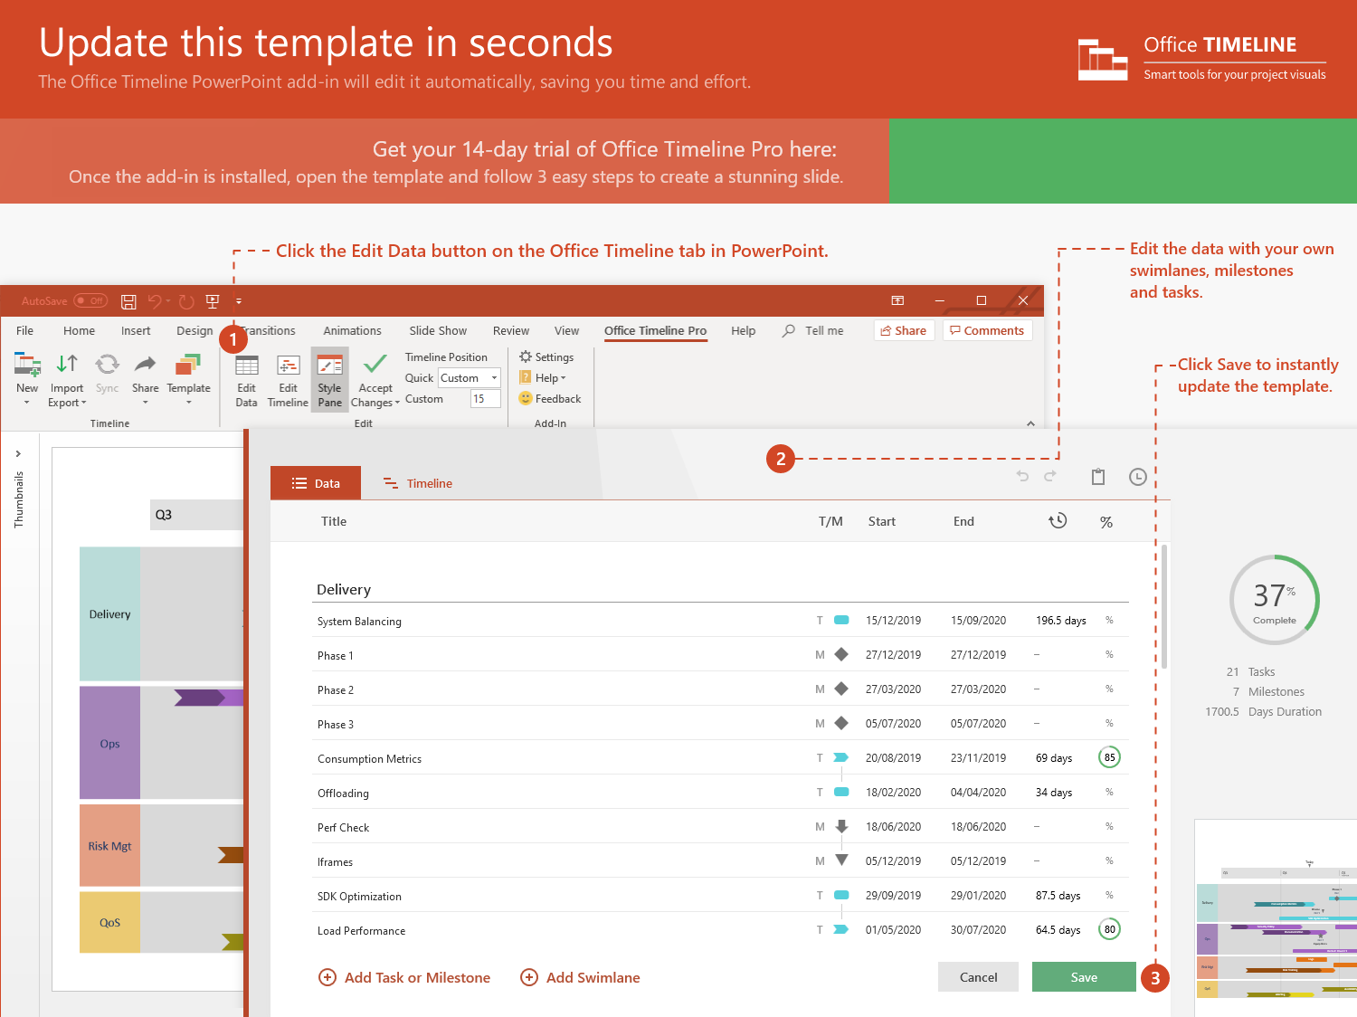
https://www.officetimeline.com/14-days-trial

Slide 2
Fifth Milestone or Event Here
April 1, 2001
First Milestone or Event Here
Seventh Milestone or Event Here
October 1, 1984
February 1, 2007
Third Milestone or Event Here
Ninth Milestone or Event Here
Today
November 22, 1991
November 9, 2013
January 15, 2021
1984
1984
1988
1992
1996
2000
2004
2008
2012
2016
2020
2023
July 14, 1988
February 4, 2017
Today
Second Milestone or Event Here
Tenth Milestone or Event Here
June 1, 2010
Eight Milestone or Event Here
July 1, 2003
Sixth Milestone or Event Here
March 1, 2000
Fourth Milestone or Event Here

